Slide 1
LEARNING PHYTON

Slide 2
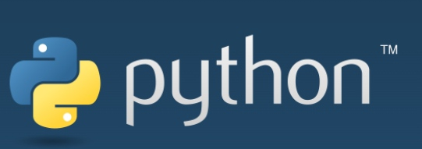
What is Python?
Python is an interpreted, object-oriented, high-level programming language with dynamic semantics. Its high-level built in data structures, combined with dynamic typing and dynamic binding, make it very attractive for Rapid Application Development, as well as for use as a scripting or glue language to connect existing components together.

Slide 3

Python Jobs
A professional who specializes in Python can hold a number of job titles, including Python Developer, Data Scientist, and Machine Learning Engineer.

Slide 4
Why Learn Python?
1. Python Is Beginner-Friendly
Why learn Python? For starters, the language is an excellent place to begin if you’re new to coding. One of the biggest hurdles for aspiring coders is the daunting task of learning a new language that looks nothing like what they’re used to reading and writing.
2. Python Is Versatile
Python is highly versatile. You can use it for both small and complex tasks, and it is used across many different industries — from its more common applications in data science and software engineering to environments like mobile app development, artificial intelligence, and machine learning.

Slide 5
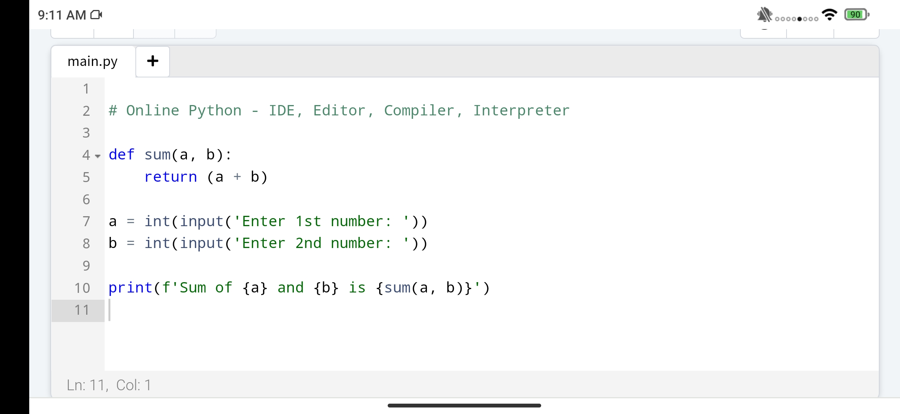
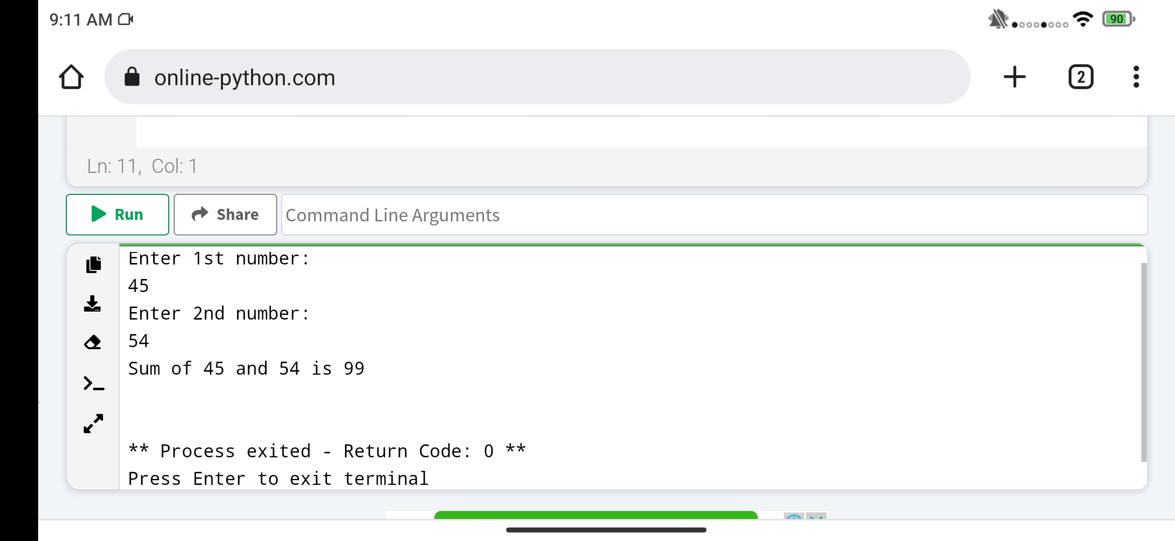
Python Interpreter 1

Slide 6
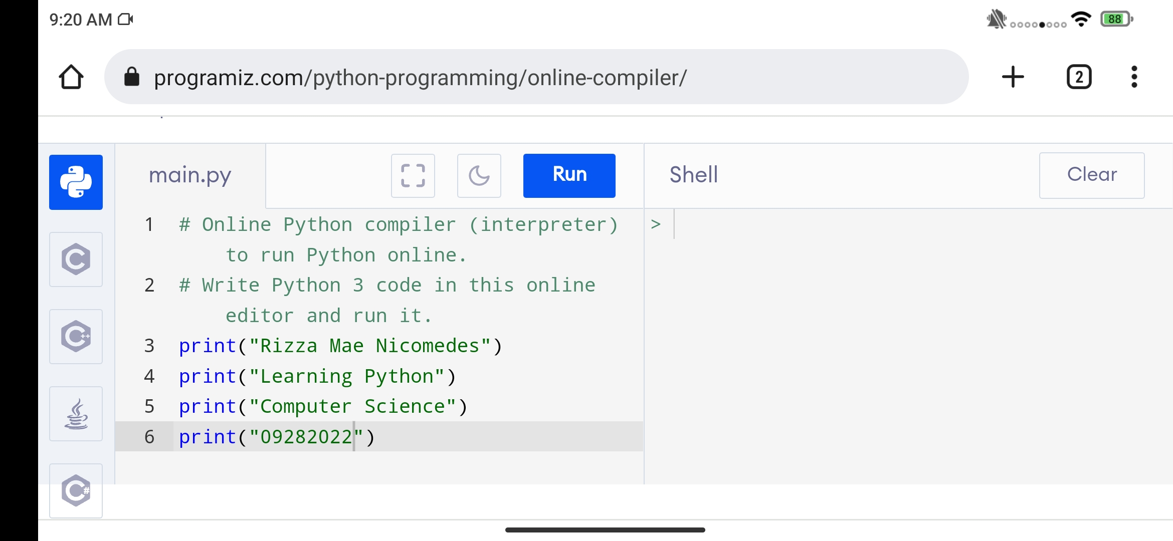
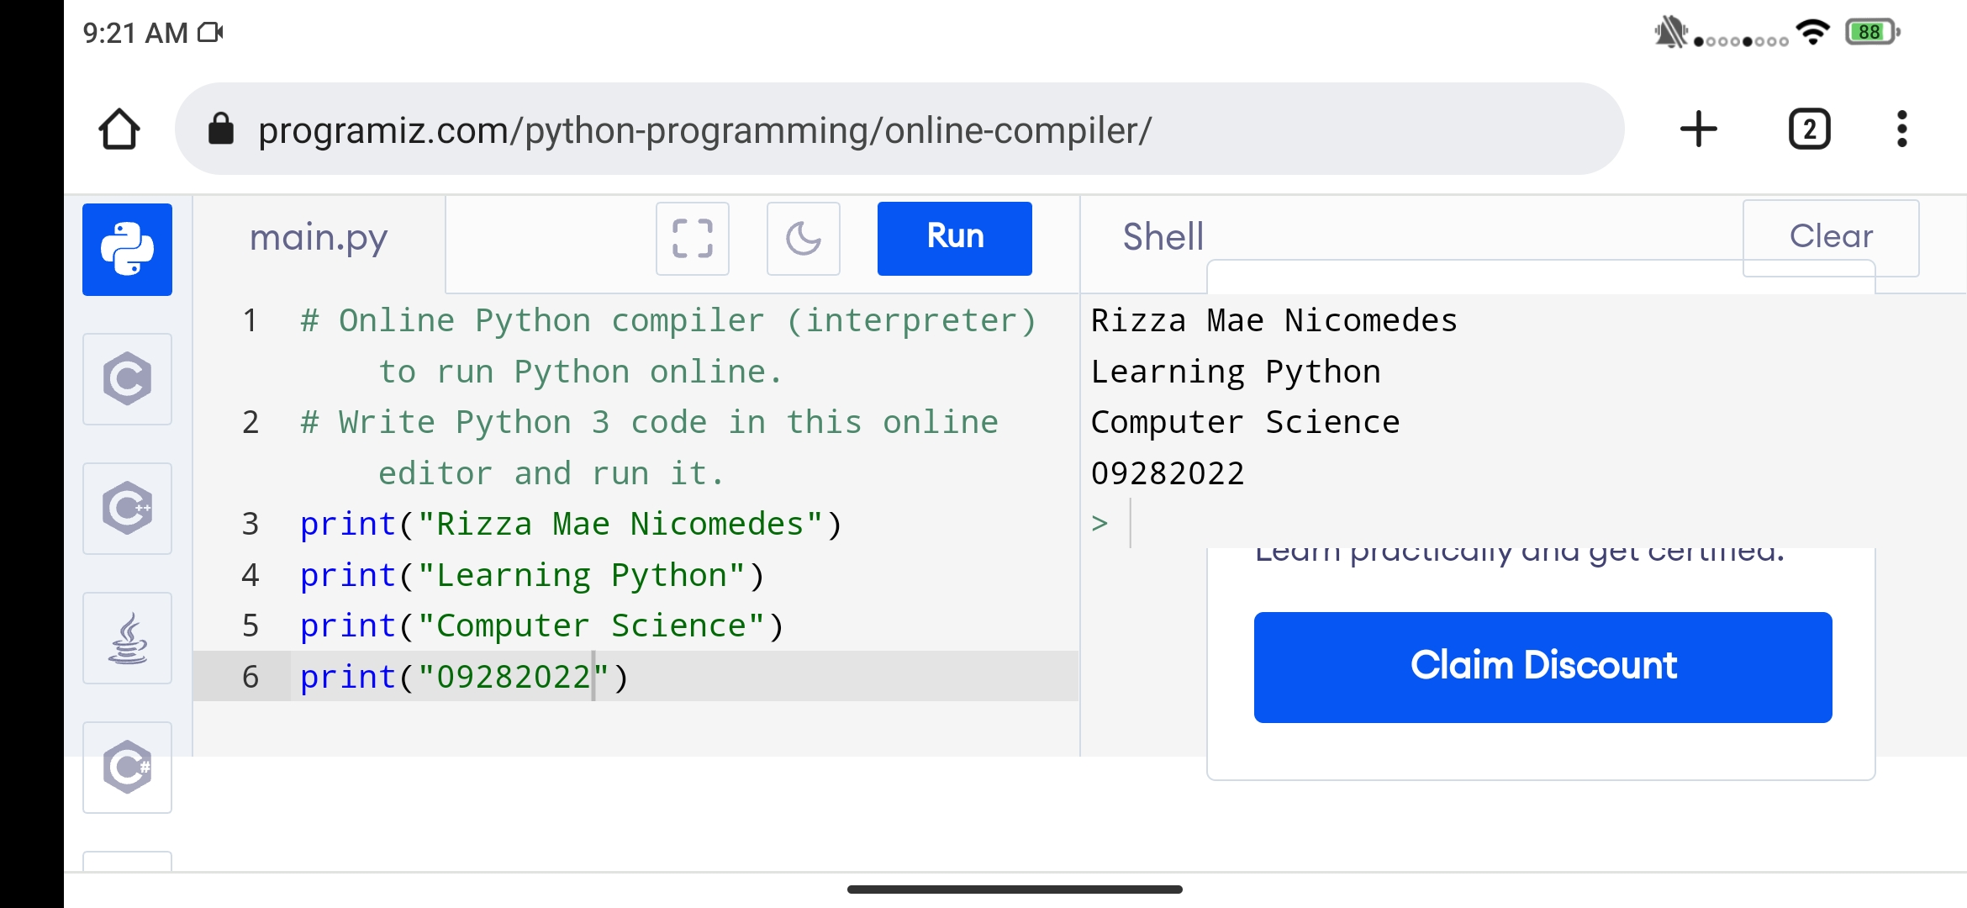
Python Interpreter 2

Slide 7
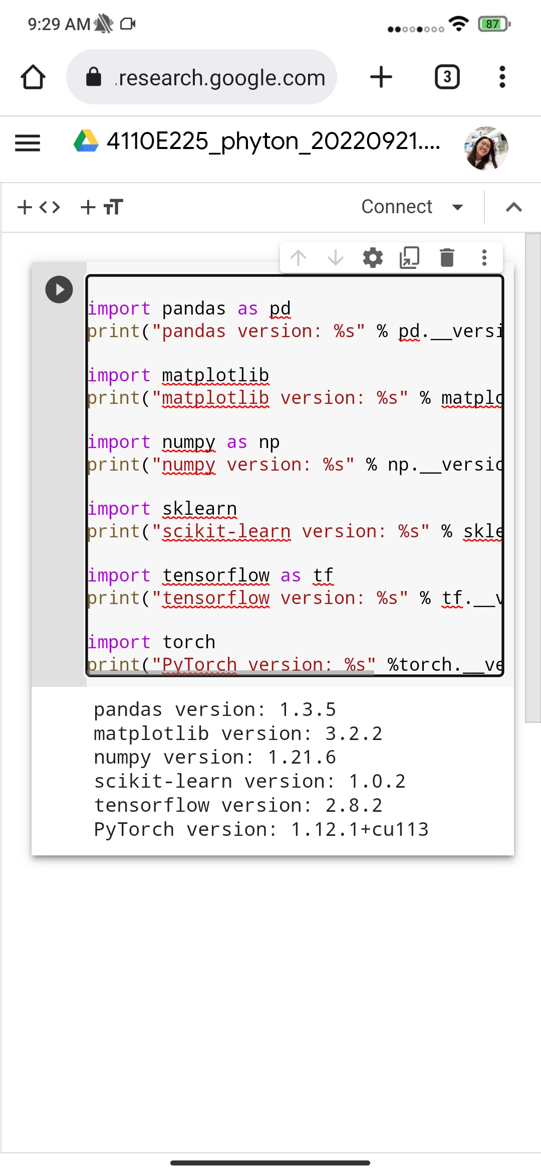




Google Colab

Slide 8
Thank You!

